Slide 1
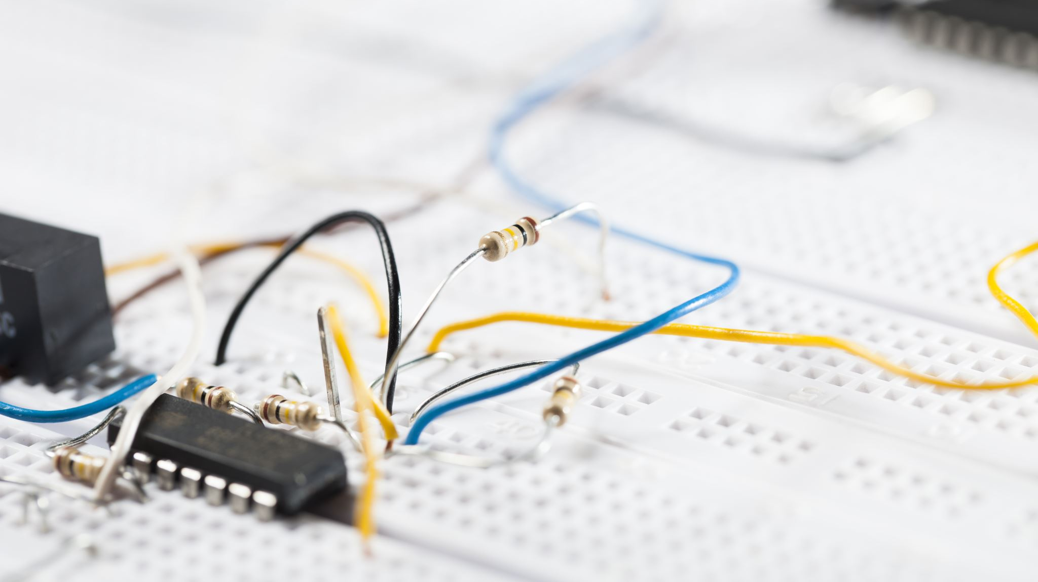
Node Voltage Analysis

Slide 2
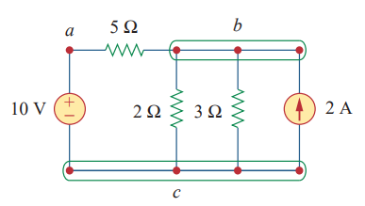
Node , Branch and Loop
Branch: Any two-terminal device
10 V Battery
2A current source
Three Resistances
Node: Junction of different branches
‘a’ node
‘b’ node
‘c’ node
Loop: Any closed path

Slide 3
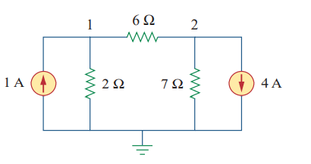
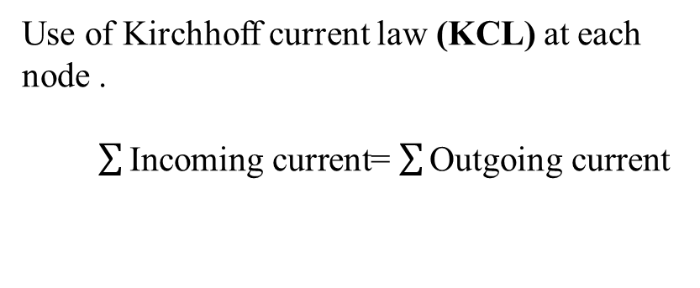
Nodal Analysis
Goal : Finding the node voltages.
Use of Kirchhoff current law (KCL) at each node .
$\sum{\text{Incoming} \text{current}}$= $\sum{\text{O}\text{utgoing} \text{current}}$
To find V₁ and V₂ , we need two equations.
Less computational complexity !

Slide 4
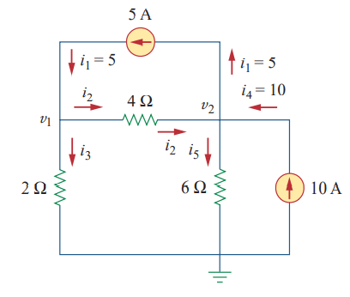
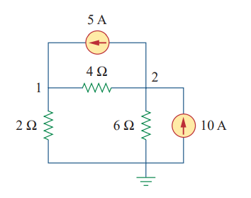
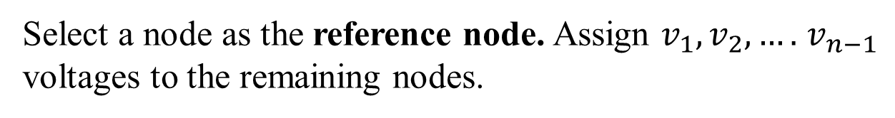
Steps to Determine Node Voltages:
Three Steps
Step 1:
Select a node as the reference node. Assign $v_{1},v_{2}, ….$ $v_{n−1}$ voltages to the remaining nodes.

Slide 5


Steps to Determine Node Voltages : (Continued)
Step 2:
Apply KCL to each of the nonreference nodes.
At node 1,
i₁ = i₂ + i₃
5 = $\frac{v1−v2}{4}+\frac{v1}{2}$
3v₁ – v₂ = 20
At node 2,
i₂ + i₄ = i₁ + i₅
$\frac{v1−v2}{4}$ + 10 = 5 $+ \frac{v2}{6}$
- 3v₁ + 5v₂ = 60
Step 3:
Solve the resulting simultaneous equations.
V₁= 13.333 V
V₂= 20 V

Slide 6
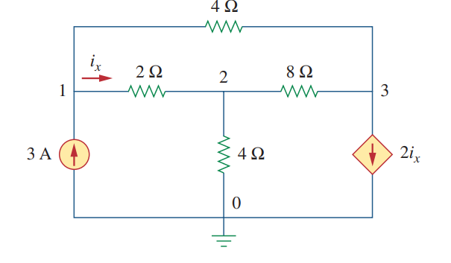
Math Problem Practice:
Determine the voltages at the nodes.
Reference: Sadiku_Example_3.2

Slide 7
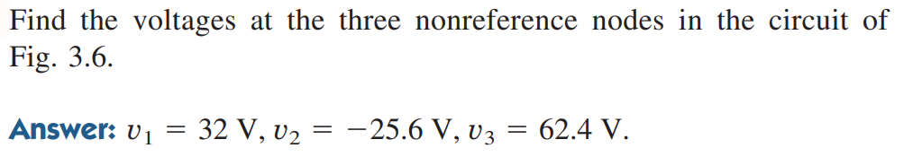
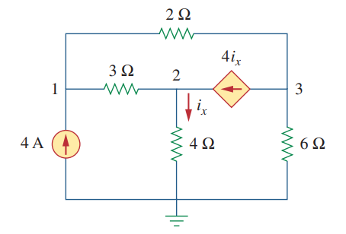
Math Problem Practice:
Reference: Sadiku_Practice_Problem_3.2

Slide 8
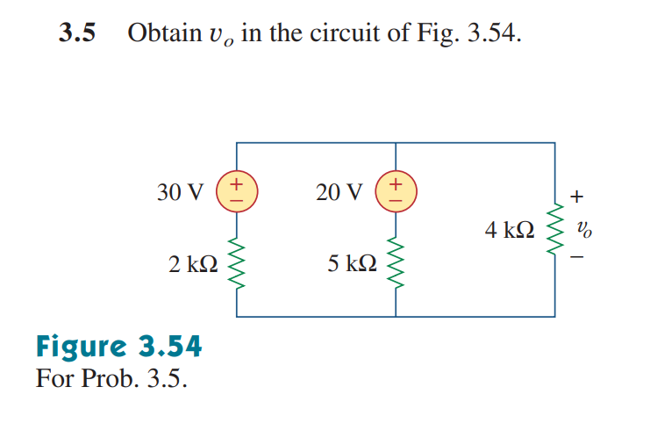
Math Problem Practice:
Reference: Sadiku_Exercise_3.5

Slide 9
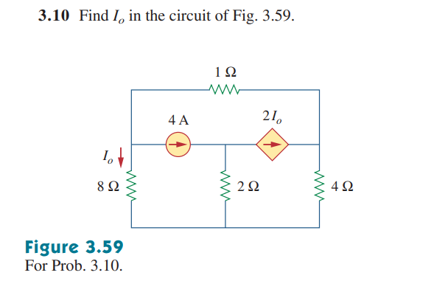
Math Problem Practice:
Reference: Sadiku_Exercise_3.10

Slide 10
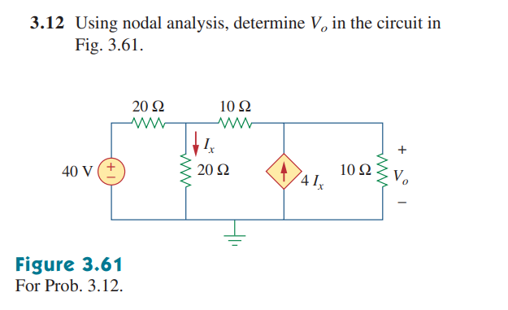
Math Problem Practice:
Reference: Sadiku_Exercise_3.12

Slide 11
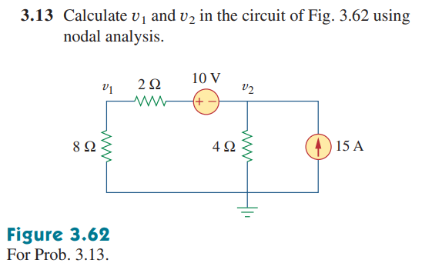
Math Problem Practice:
Reference: Sadiku_Exercise_3.13

Slide 12
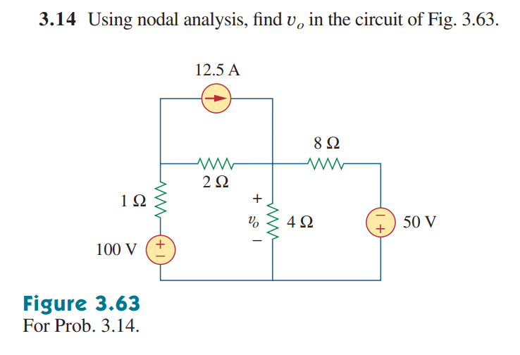
Math Problem Practice:
Reference: Sadiku_Exercise_3.14

Slide 13
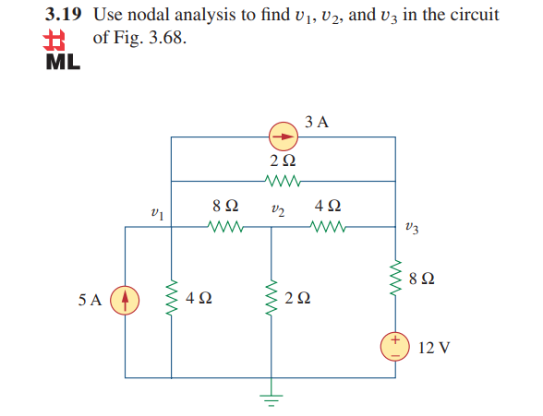
Math Problem Practice:
Reference: Sadiku_Exercise_3.19

Slide 14
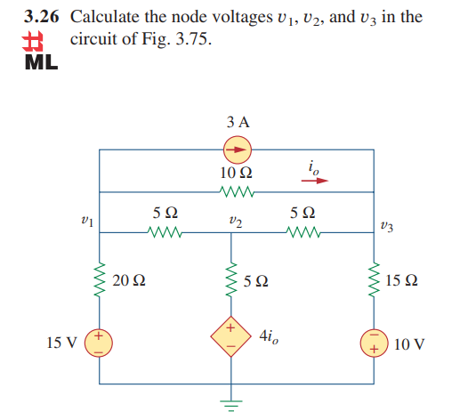
Math Problem Practice:
Reference: Sadiku_Exercise_3.26

Slide 15
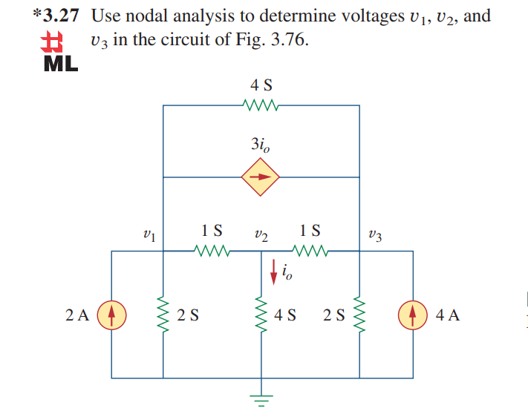
Math Problem Practice:
Reference: Sadiku_Exercise_3.27

Slide 16
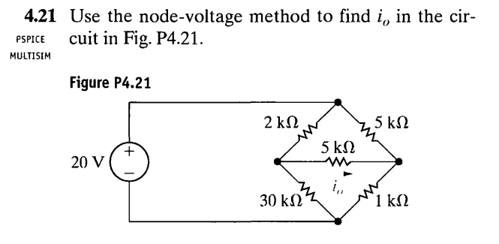
Math Problem Practice:
Reference: Nilsson_Exercise_4.21

Slide 17
Thank You for patient Hearing

